Slide 1
PREDICTING WHETHER A TWEET IS NEGATIVE OR POSITIVE

Slide 2
TEAM MEMBERS:
IYLINE CHUMO
JACKSON KYALO
BRIAN MICHIRA
DENNIS KIARIE

Slide 3
US AIRLINES SENTIMENT ANALYSIS
OVERVIEW
An airline is a company that provides air transport services for travelling passengers and freight.Airlines utilize aircraft to supply these services and may form partnerships with other airlines for code-share agreements to offer and operate the same flight.
With the rising economy,the airline industry is expanding and every airline is looking to remain relevant to retain and attract more customers.

Slide 4
PROBLEM STATEMENT
There has been a turnover decline in profit margins for the Airlines and as a result they would like to get feedback from their customers on their flight experience to implement effective solutions oh how they will maintain and attract more clients and in return increase their profits.

Slide 5
Objective
Our research seeks to predict the tweets using Neural Networks and provide insights of the best solution for the airlines to gain more customers and increase their profit margins by analysing their customer’s flight experience.
Impact
The airlines can use the analysis to come up with strategies to improve their services to attract more customers and in return increase the profit margin and expand their business.Also coming up with innovative ways to make make customer experience better.

Slide 6
Project Workflow
1.Defining the Question
2.Reading the Data
3.Data Exploration
4.Data Cleaning
5.Exploratory Data Analysis
6.Model Evaluation
7..Challenging the solutions
8..Conclusion

Slide 7
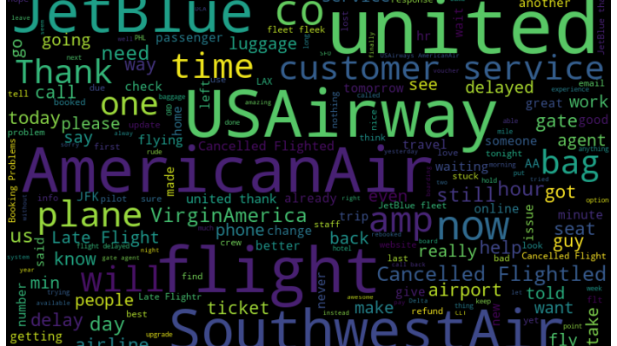
EDA : Frequent words

Slide 8
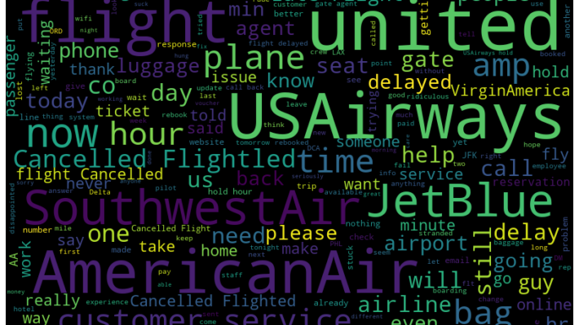
Negative Words

Slide 9
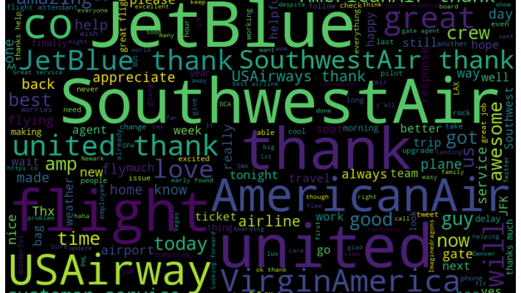
Positive words

Slide 10
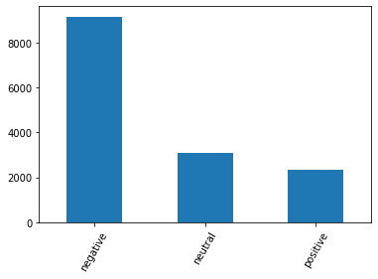
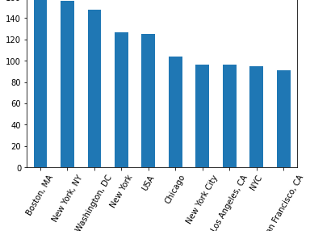
EDA Findings
From the bar ,we can conclude that majority of the sentiments are negative followed by neutral and positive sentiments with the least percentage.
Most tweets are from Boston, New york

Slide 11
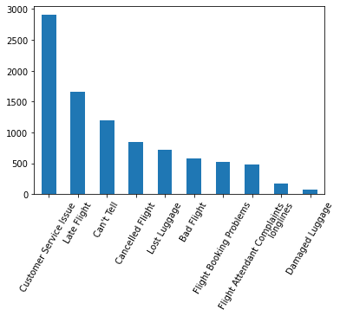
4.The most negative sentiments were about customer services followed by late flight.

Slide 12
MODELLING
We build a tensorflow model using sequent model and embedding layers, while passing a sigmoid activation to compute the output. Our loss function was binary cross-entropy with an optimizer of adam. We used the accuracy metrics to evaluate the performance of the model. The model did not perform well with an accuracy of 78% and validation accuracy of 85%.
We tuned the hyperparameters and added a spatial dropout and dropout to reduce the probability of the neurals learning from each other. We also used LSTM as an hyperparameter. Our model accuracy increased to 95% and validation accuracy to 94%. The loss and validation loss also reduced significantly.

Slide 13
RECOMMENDATION
We recommend that the airlines to educate their staff on customer services.
The airlines should communication in case of any flight delays.
Also,the airlines should make advanced communication in case any flight is to be canceled.

Slide 14
Q&A

